Slide 1
Software Development Tools & Practices PUSL2020 Level 2
“Validation”
Dr. Rasika Ranaweera (ranaweera.r@nsbm.ac.lk | +94 11 544 6126)
Faculty of Faculty of Postgraduate Studies & Professional Advancement | NSBM Green University

Slide 2
What is form validation?
validation: ensuring that form's values are correct
some types of validation:
preventing blank values (email address)
ensuring the type of values
integer, real number, currency, phone number, Social Security number, postal address, email address, date, credit card number, ...
ensuring the format and range of values (ZIP code must be a 5-digit integer)
ensuring that values fit together (user types email twice, and the two must match)

Slide 3
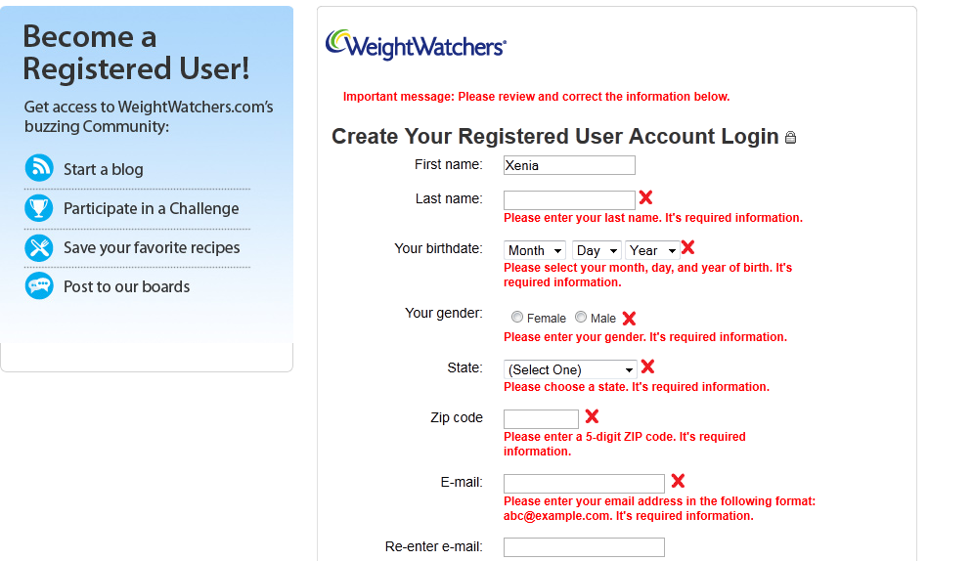
A real Form that uses validation

Slide 4
Client vs. server-side validation
Validation can be performed:
client-side (before the form is submitted)
can lead to a better user experience, but not secure (why not?)
server-side (in PHP code, after the form is submitted)
needed for truly secure validation, but slower
both
best mix of convenience and security, but requires most effort to program

Slide 5
An example form to be validated
<form action="http://foo.com/foo.php" method="get">
<div>
City: <input name="city" /> <br />
State: <input name="state" size="2" maxlength="2" /> <br />
ZIP: <input name="zip" size="5" maxlength="5" /> <br />
<input type="submit" />
</div>
</form> HTML
Let's validate this form's data on the server...

Slide 6
Basic server-side validation code - PHP
<?php
$city = $_REQUEST["city"];
$state = $_REQUEST["state"];
$zip = $_REQUEST["zip"];
if (!$city || strlen($state) != 2 || strlen($zip) != 5) {
?>
<h2>Error, invalid city/state submitted.</h2>
<?php
}
?> PHP
basic idea: examine parameter values, and if they are bad, show an error message and abort
Notes:
Maybe delete the comments that give out the output

Slide 7
Basic server-side validation code
validation code can take a lot of time / lines to write
How do you test for integers vs. real numbers vs. strings?
How do you test for a valid credit card number?
How do you test that a person's name has a middle initial?
How do you test whether a given string matches a particular complex format?

Slide 8
Basic Regular Expression
/abc/
in PHP, regexes are strings that begin and end with /
the simplest regexes simply match a particular substring
the above regular expression matches any string containing "abc":
YES: "abc", "abcdef", "defabc", ".=.abc.=.", ...
NO: "fedcba", "ab c", "PHP", ...

Slide 9
Wildcards
A dot . matches any character except a \n line break
"/.oo.y/" matches "Doocy", "goofy", "LooNy", ...
A trailing i at the end of a regex (after the closing /) signifies a case-insensitive match
"/xen/i" matches “Xenia", “xenophobic", “Xena the warrior princess", “XEN technologies” ...

Slide 10
Special characters: |, (), ^, \
| means OR
"/abc|def|g/" matches "abc", "def", or "g"
There's no AND symbol. Why not?
() are for grouping
"/(Homer|Marge) Simpson/" matches "Homer Simpson" or "Marge Simpson"
^ matches the beginning of a line; $ the end
"/^<!--$/" matches a line that consists entirely of "<!--"

Slide 11
Exercise
Write a regular expression to find line breaks in an HTML file.

Slide 12
Special characters: |, (), ^, \
\ starts an escape sequence
many characters must be escaped to match them literally: / \ $ . [ ] ( ) ^ * + ?
"/<br \/>/" matches lines containing <br /> tags

Slide 13
Quantifiers: *, +, ?
* means 0 or more occurrences
"/abc*/" matches "ab", "abc", "abcc", "abccc", ...
"/a(bc)*/" matches "a", "abc", "abcbc", "abcbcbc", ...
"/a.*a/" matches "aa", "aba", "a8qa", "a!?_a", ...
+ means 1 or more occurrences
"/a(bc)+/" matches "abc", "abcbc", "abcbcbc", ...
"/Goo+gle/" matches "Google", "Gooogle", "Goooogle", ...
? means 0 or 1 occurrences
"/a(bc)?/" matches "a" or "abc"

Slide 14
More quantifiers: {min,max}
{min,max} means between min and max occurrences (inclusive)
"/a(bc){2,4}/" matches "abcbc", "abcbcbc", or "abcbcbcbc"
min or max may be omitted to specify any number
{2,} means 2 or more
{,6} means up to 6
{3} means exactly 3

Slide 15
Character sets: []
[] group characters into a character set; will match any single character from the set
"/[bcd]art/" matches strings containing "bart", "cart", and "dart"
equivalent to "/(b|c|d)art/" but shorter
inside [], many of the modifier keys act as normal characters
"/what[!*?]*/" matches "what", "what!", "what?**!", "what??!",
Notes:
"/[ACGT]+/"

Slide 16
Character ranges: [start-end]
inside a character set, specify a range of characters with -
"/[a-z]/" matches any lowercase letter
"/[a-zA-Z0-9]/" matches any lower- or uppercase letter or digit
an initial ^ inside a character set negates it
"/[^abcd]/" matches any character other than a, b, c, or d

Slide 17
Character ranges: [start-end]
inside a character set, - must be escaped to be matched
"/[+\-]?[0-9]+/" matches an optional + or -, followed by at least one digit
Notes:
"/[ABCDF][+\-]?/"

Slide 18
Escape sequences
special escape sequence character sets:
\d matches any digit (same as [0-9]); \D any non-digit ([^0-9])
\w matches any “word character” (same as [a-zA-Z_0-9]); \W any non-word
char
\s matches any whitespace character ( , \t, \n, etc.); \S any non-whitespace
Notes:
"/\$\d{3,}\.\d{2}/"

Slide 19
Regular expressions in PHP
regex syntax: strings that begin and end with /, such as "/[AEIOU]+/"
preg_match(regex, string) | returns TRUE if string matches regex
preg_replace(regex, replacement, string) | returns a new string with all substrings that match regex replaced by replacement
preg_split(regex, string) | returns an array of strings from given string broken apart using the given regex as the delimiter (similar to explode but more powerful)

Slide 20
Regular expressions example
echo preg_match ('/test/', "a test of preg_match");
echo preg_match ('/tutorial/', "a test of preg_match");
$matchesarray[0] = "http://www.tipsntutorials.com/" $matchesarray[1] = "http://" $matchesarray[2] = "www.tipsntutorials.com/"
preg_match ('/(http://)(.*)/', $matchesarray) PHP
Notes:
What is the output?

Slide 21
Regular expressions example
# replace vowels with stars
$str = "the quick brown fox";
$str = preg_replace("/[aeiou]/", "*", $str);
# "th* q**ck br*wn f*x“
# break apart into words
$words = preg_split("/[ ]+/", $str);
# ("th*", "q**ck", "br*wn", "f*x")
# capitalize words that had 2+ consecutive vowels
for ($i = 0; $i < count($words); $i++) {
if (preg_match("/\\*{2,}/", $words[$i])) {
$words[$i] = strtoupper($words[$i]);
}
} # ("th*", "Q**CK", "br*wn", "f*x") PHP
Notes:
What is the output?
notice how \ must be escaped to \\

Slide 22
Regular expressions example
# replace vowels with stars
$str = “stay hungry stay foolish";
$str = preg_replace("/[aeiou]/", "*", $str);
#
# break apart into words
$words = preg_split("/[ ]+/", $str);
#
# capitalize words that had 2+ consecutive vowels
for ($i = 0; $i < count($words); $i++) {
if (preg_match("/\\*{2,}/", $words[$i])) {
$words[$i] = strtoupper($words[$i]);
}
} # PHP
Notes:
What is the output?
notice how \ must be escaped to \\

Slide 23
Why validate?
XSS (Cross Site Scripting)
SQLI (SQL Injection)
Code | Sample
Application code | <input value="userInput”>
Malicious string | "><script>...</script><input value=”
Resulting code | <input value=""><script>...</script><input value="">
Code | Sample
Application code | SELECT * FROM Users WHERE Username='$username' AND Password='$password'
Malicious string | $username = 1' or '1' = '1
Resulting code | SELECT * FROM Users WHERE Username='1' OR '1' = '1' AND Password='1' OR '1' = '1'

Slide 24
Exercise
Write regular expression to validate
The first character is uppercase or not
The value is hexadecimal or not
Hex-color or not (/^#?([0-9a-fA-F]{3}|[0-9a-fA-F]{6})$/)
Write a PHP program to count the number of words in a string.
- Remove white-space from start and end position.
- Convert 2 or more spaces to 1.
- Exclude newline with a start spacing.
Notes:
The first character is uppercase or not
/^[A-Z]/
Hexadecimal value or not
/^[0-9a-fA-F]+$/;
Hexcolor or not
/^#?([0-9a-fA-F]{3}|[0-9a-fA-F]{6})$/

Slide 25
Word Counter
$str = "the quick brown fox";
# exclude start and end white-space
$str1 = preg_replace(“/(^\s*)|(\s*$)/i”,"”, $str);
# convert 2 or more spaces to 1
$str1 = preg_replace(“/[ ]{2,}/i”," ”, $str1);
// exclude newline with a start spacing
$str1 = preg_replace(“/\n /”,"\n”, $str1);
preg_split(“ “, $str1).length;
PHP
Notes:
What is the output?
notice how \ must be escaped to \\

Slide 26
ASP.NET Validation Controls (Introduction)
The ASP.NET validation controls can be used to validate data on the client, the server, or both
Client-side validation is performed using automatically generated JavaScript
Server-side validation is performed using VB or C# code in the proper event handler
Server-side validation is always enabled while client-side validation is optionally enabled
Notes:
From Here

Slide 27
ASP.NET Validation Controls (Introduction)
If client-side validation is enabled, we don’t postback until the client ‘thinks’ the values are valid
Always validate on the server-side too to thwart those hackers doing a post on their own

Slide 28
ASP.NET Validation Controls (Server Processing Model 1)
Validation controls apply their rules and validate a corresponding control
Call the Page.Validate() method to force the validation controls to execute
This is usually not necessary
Test Page.IsValid to determine whether the page has valid data or not

Slide 29
ASP.NET Validation Controls (Server Processing Model 2)
Page states
Controls are initialized and populated when the page is loaded
After the page loads, the controls are validated and the Page.IsValid property is set
The Page.Validators property contains results of each control’s validator
Each item in the collection implements IValidator

Slide 30
ASP.NET Validation Controls (Concepts)
Set the ControlToValidate property the control instance that will be validated
Set EnableClientScript to enable client-side validation
ASP will generate the necessary JavaScript
Set the ErrorMessage property to the error message that will appear in the validation control

Slide 31
ASP.NET Validation Controls (RequiredFieldValidator and RangeValidator)
RequiredFieldValidator checks that a control has a value
RangeValidator checks that a controls value is within a valid range
Set the MinimumValue and MaximumValue properties to the valid range
A control with no valid is considered valid
Use with the RequiredFieldValidator to prevent this
<asp:RangeValidator ID="rvclass"
runat="server"
ControlToValidate="txtclass"
ErrorMessage="Enter your class (6 - 12)"
MaximumValue="12"
MinimumValue="6" Type="Integer">
</asp:RangeValidator>
<asp:RequiredFieldValidator ID="rfvcandidate"
runat="server" ControlToValidate ="ddlcandidate"
ErrorMessage="Please choose a candidate"
InitialValue="Please choose a candidate">
</asp:RequiredFieldValidator>

Slide 32
ASP.NET Validation Controls (CompareValidator)
The CompareValidator validates that the values of two other control instances are the same
Set the ControlToValidate and ControlToCompare properties
Optionally use a RequiredFieldValidator so that empty controls will not be valid

Slide 33
ASP.NET Validation Controls (CustomValidator)
The CustomValidator control allows you to easily create custom and client script and server event handlers
Set the ControlToValidate as usual
Set the ClientValidationFunction to the name of the JavaScript function appearing on the client
Server-side validation is automatic
You must write the code for the ServerValidate event handler

Slide 34
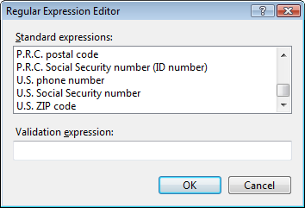
ASP.NET Validation Controls (RegularExpressionValidator)
It validates another control instance against a regular expression
The regular expression is stored in the ValidationExpression property

Slide 35
Q & A

